Slide 1
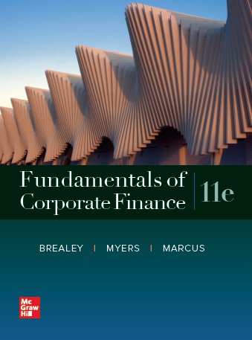
Fundamentals of Corporate Finance, 11th Edition
CHAPTER 5: The Time Value Of Money
© McGraw Hill LLC. All rights reserved. No reproduction or distribution without the prior written consent of McGraw Hill LLC.

Slide 2
Time Value of Money
Let’s start this week with a quick review of a couple of last week’s HW problems
Focus on “thought process” to find solution →Excel
Notes:
38

Slide 3
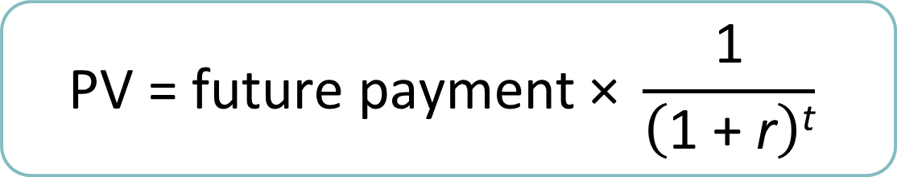
Time Value of Money (Applications)
The PV formula has many applications. Given any variables in the equation, you can solve for the remaining variable. Excel
$$\text{PV}\text{ = }\text{future} \text{payment}\text{ × }\frac{\text{1}}{\left(\text{1 + }\text{r}\right)\text{t}}$$
Notes:
38

Slide 4
Perpetuities and Annuities
Annuity
Level stream of cash flows at regular intervals with payment at END of time period, with a finite maturity
Can use similar approach as you use for Cash Flow Stream
Can also use PMT (payment) function in Excel or calculator
Notes:
44

Slide 5
Calculations: Part 1 – Financial Calculators
Example
You need a 6.5% annual return to justify the risks of the following financial contract: you will receive annual payments of $50 for five years and one lump sum payment of $1,000 in five years. What price should you pay for the contract?
1000
50 50 50 50 50
0 1 2 3 4 5
? r = 6.5%
PV function in Excel: $937.66 (discuss)
Notes:
51

Slide 6
Perpetuities and Annuities
Annuity Due
Level stream of cash flows at regular intervals with payment at BEGINNING of time period, with a finite maturity
Can use similar approach as you use for Cash Flow Stream
Can also use PMT (payment) function in Excel or calculator
Notes:
44

Slide 7
Perpetuities and Annuities
Annuity Due
See Excel for example
Notes:
44

Slide 8
Perpetuities and Annuities
Perpetuity
A stream of level cash payments that never ends
Difficult: an infinite stream of payments that nevertheless has a finite value
Notes:
44

Slide 9

Perpetuities and Annuities
PV of Perpetuity Formula
$$\text{PV}\text{ =} \frac{\text{PMT}}{\text{r}}$$
PMT = cash payment
r = interest rate
“Capitalization”
Notes:
45

Slide 10
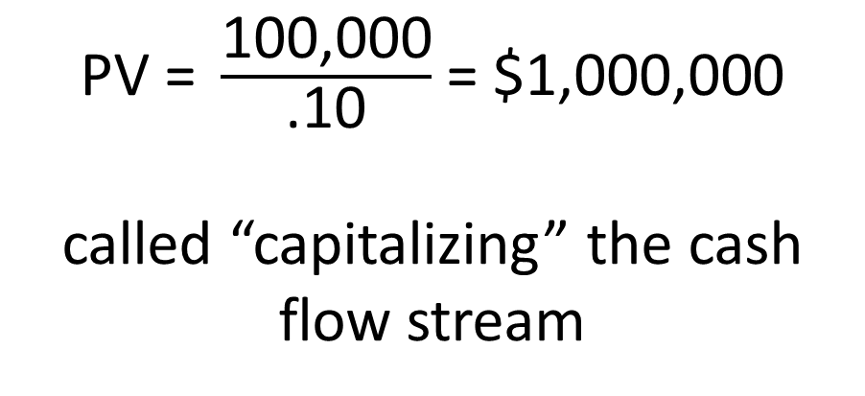
Perpetuities and Annuities
Example
In order to create an endowment, which pays $100,000 per year forever, how much money must be set aside today in the rate of interest is 10%?
$\text{PV}\text{ = }\frac{\text{100,000}}{\text{.10}}$ $\text{=}\text{ \$1,000,000}$
called “capitalizing” the cash flow stream
Notes:
47

Slide 11

Perpetuities and Annuities
Example, continued
To understand Perpetuity, re-arrange the math:
$\text{PV}\text{ = }\frac{\text{100,000}}{\text{.10}}$ $\text{=}\text{ \$1,000,000}$
is the same as
$1,000,000 x .10 =$100,000
Why is your account worth $1M? Because it produces annual Cash Flow of $100K for the 10% risk
Notes:
47

